Slide 1











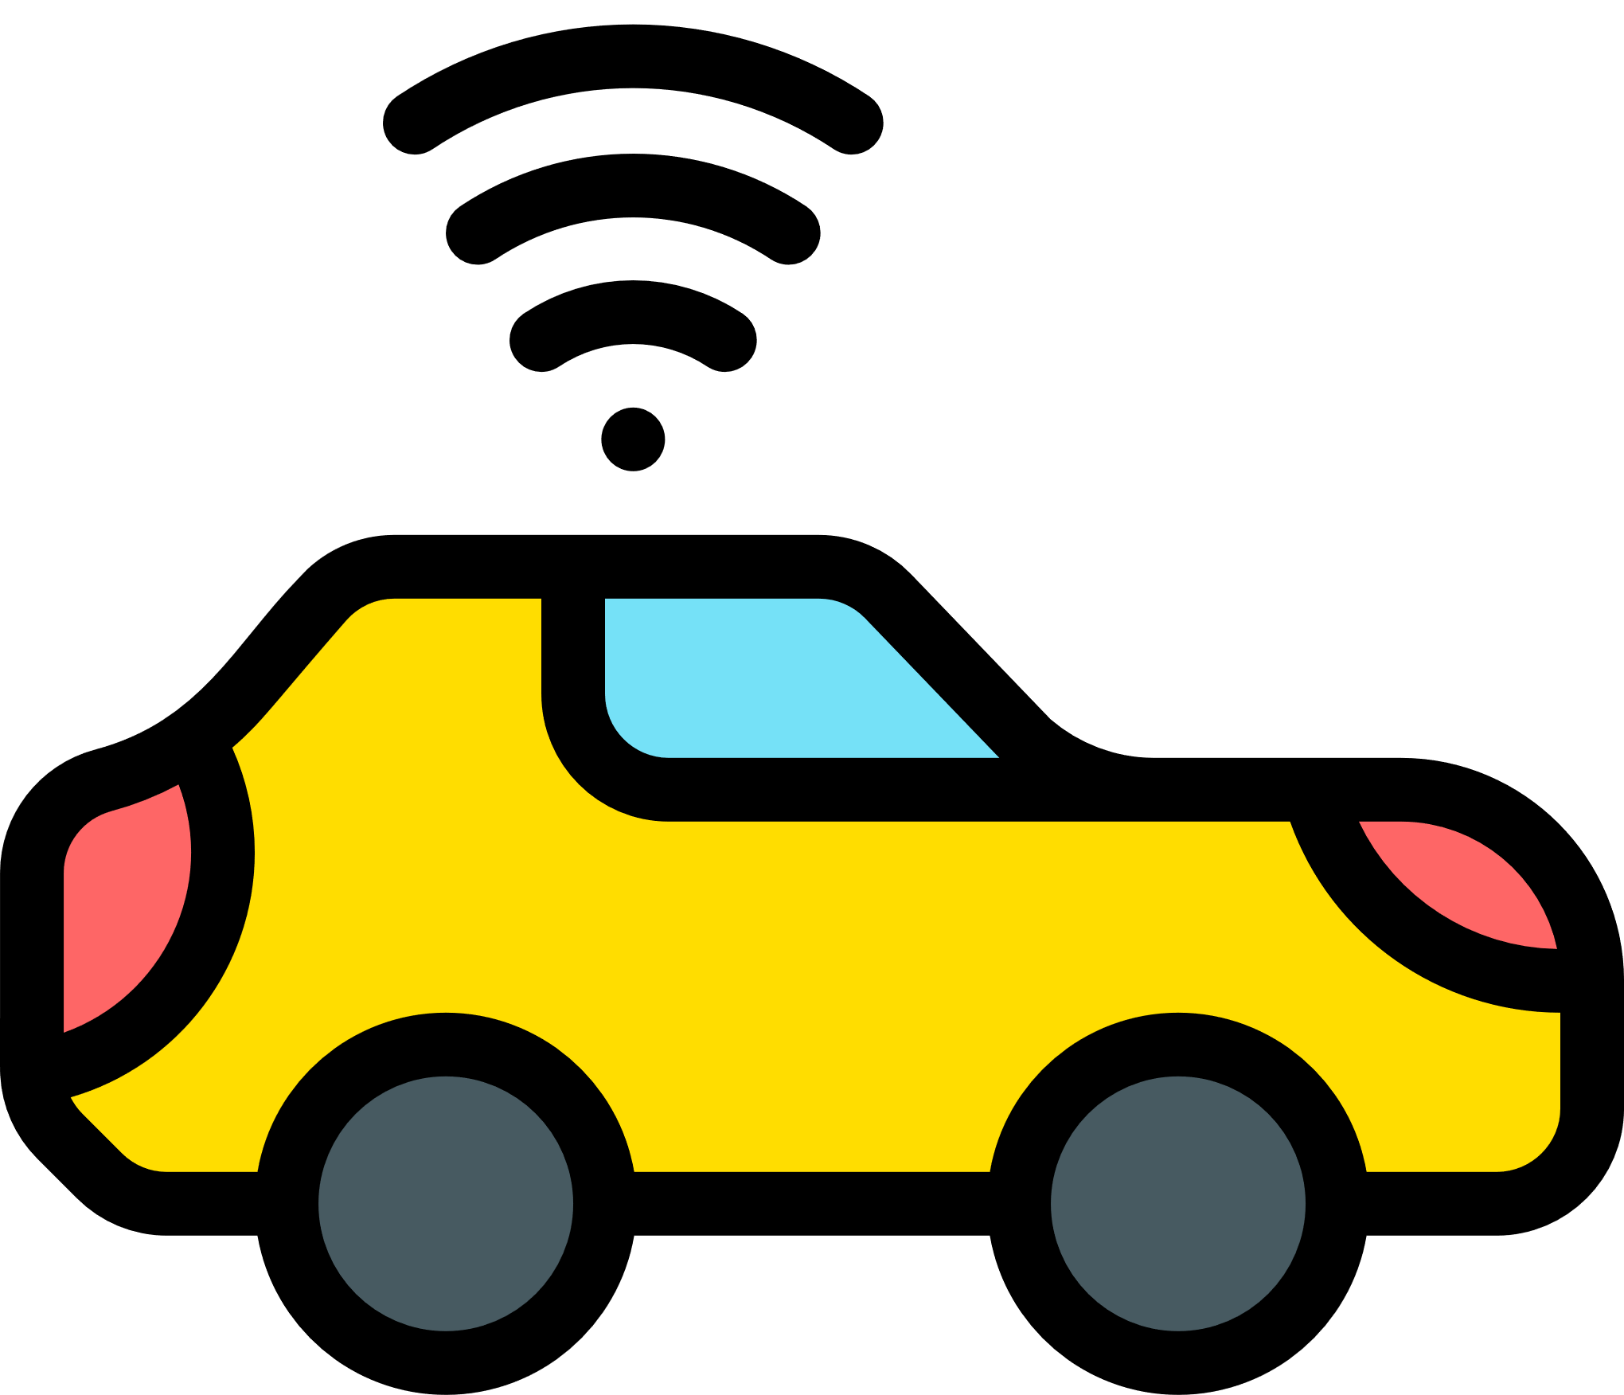





AutoCare
Emergency Health Detection and Collaborative Autonomous Driving Support in Autonomous Cars
V2I & V2N
Communication Modules
Presented by Dilek Taylı
21.01.2023

Slide 2

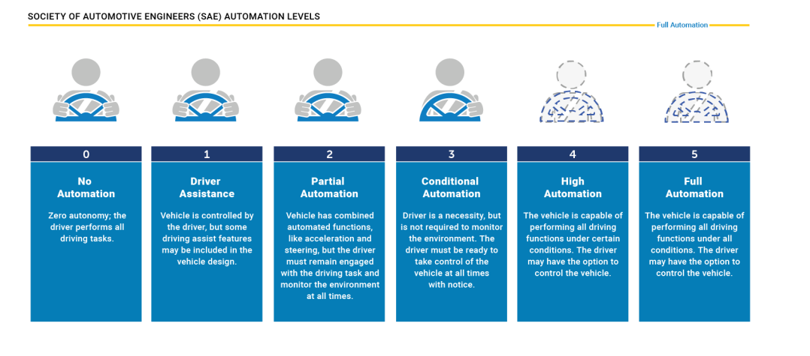

Background
Autonomous Vehicles:
equipped with sophisticated sensors and intelligent algorithms, have the potential to reform the way we commute, offering increased safety, efficieny, and convenience.
[1]

Slide 3

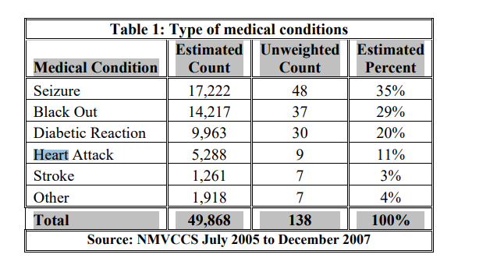
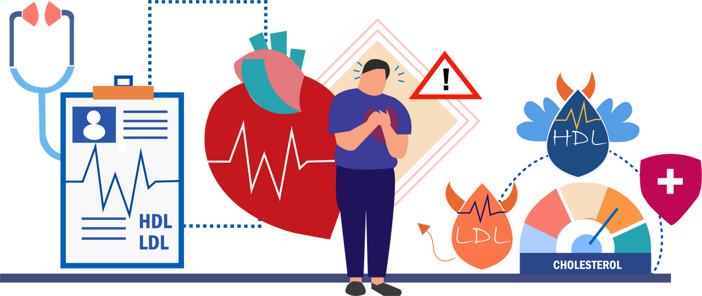
What is the problem
Driver’s profile in terms of medical conditions
Lack of studies after heart attack detection
Kalitzin et al. (2012) used 72 different attack videos of 50 people in his study on the detection of attacks [3].
In Chowdhury et al. (2019) article, the driver's heart attack detection reached a successful prediction rate of over 96 percent, thanks to the watch-style device that the driver can wear on his arm [4].
[2]

Slide 4

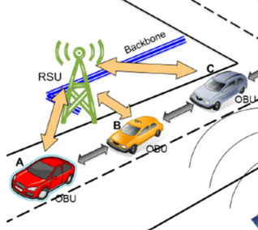
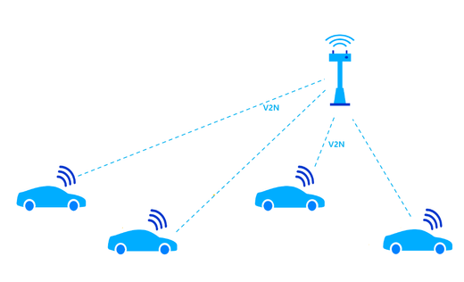

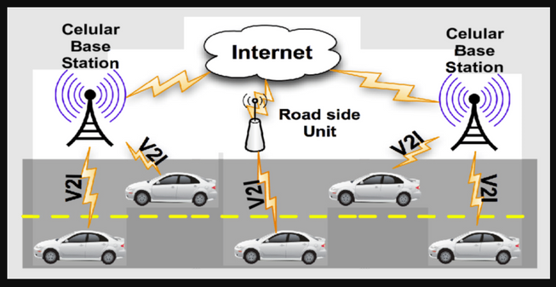

Road Side Units:
When the vehicles are not close to each other but will be learning about the car with the emergency by just connecting to the road side units.
Vehicle to Network:
enables vehicles to communicate with the internet using cellular networks.
Technical Approaches and Methods
Cellular Base Station:
essential communication nodes, enabling real-time data exchange, continuous connectivity, and access to cloud services to enhance safety issues
Tools I am using during the project:
Omnet++ (5.6.2)
Sumo (1.7.0)
Veins (5.0)
Inet4
Open Street Map
Java OpenStreet Map Editor

Slide 5
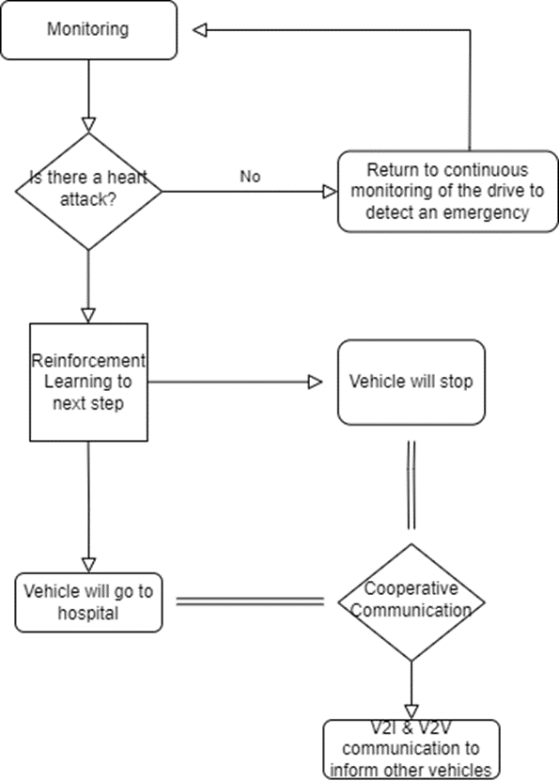
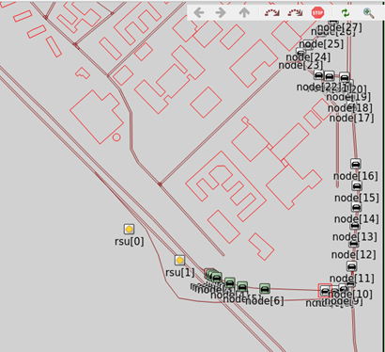
System Model
Flow Chart
Design

Slide 6

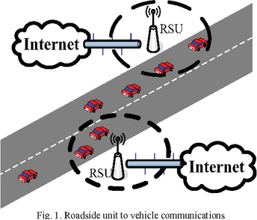

Comparison of Technical Approaches
01 - RSU (V2I)
02 - V2V
There are several protocols that are used in Road side unit implementation.
IEEE 802.11p (WAVE): designed to meet the challenges of high-mobility environments, providing short-range, low-latency communication suitable for applications such as collision avoidance and cooperative adaptive cruise control.
LTE (Long-Term Evolution): provide high data rates, low latency, and efficient use of the radio spectrum.
it is a communication type that is between vehicles to cooperate with each other to enhance safety.
It could be more suitable for rural areas since implementing RSU there could be expensive and inefficient
However, the effectiveness of V2V communication relies heavily on the proximity of other vehicles equipped with the necessary communication technology. In dense urban environments or areas with sparse traffic, there might be instances where vehicles are not in close proximity to each other, leading to limited opportunities for communication.

Slide 7
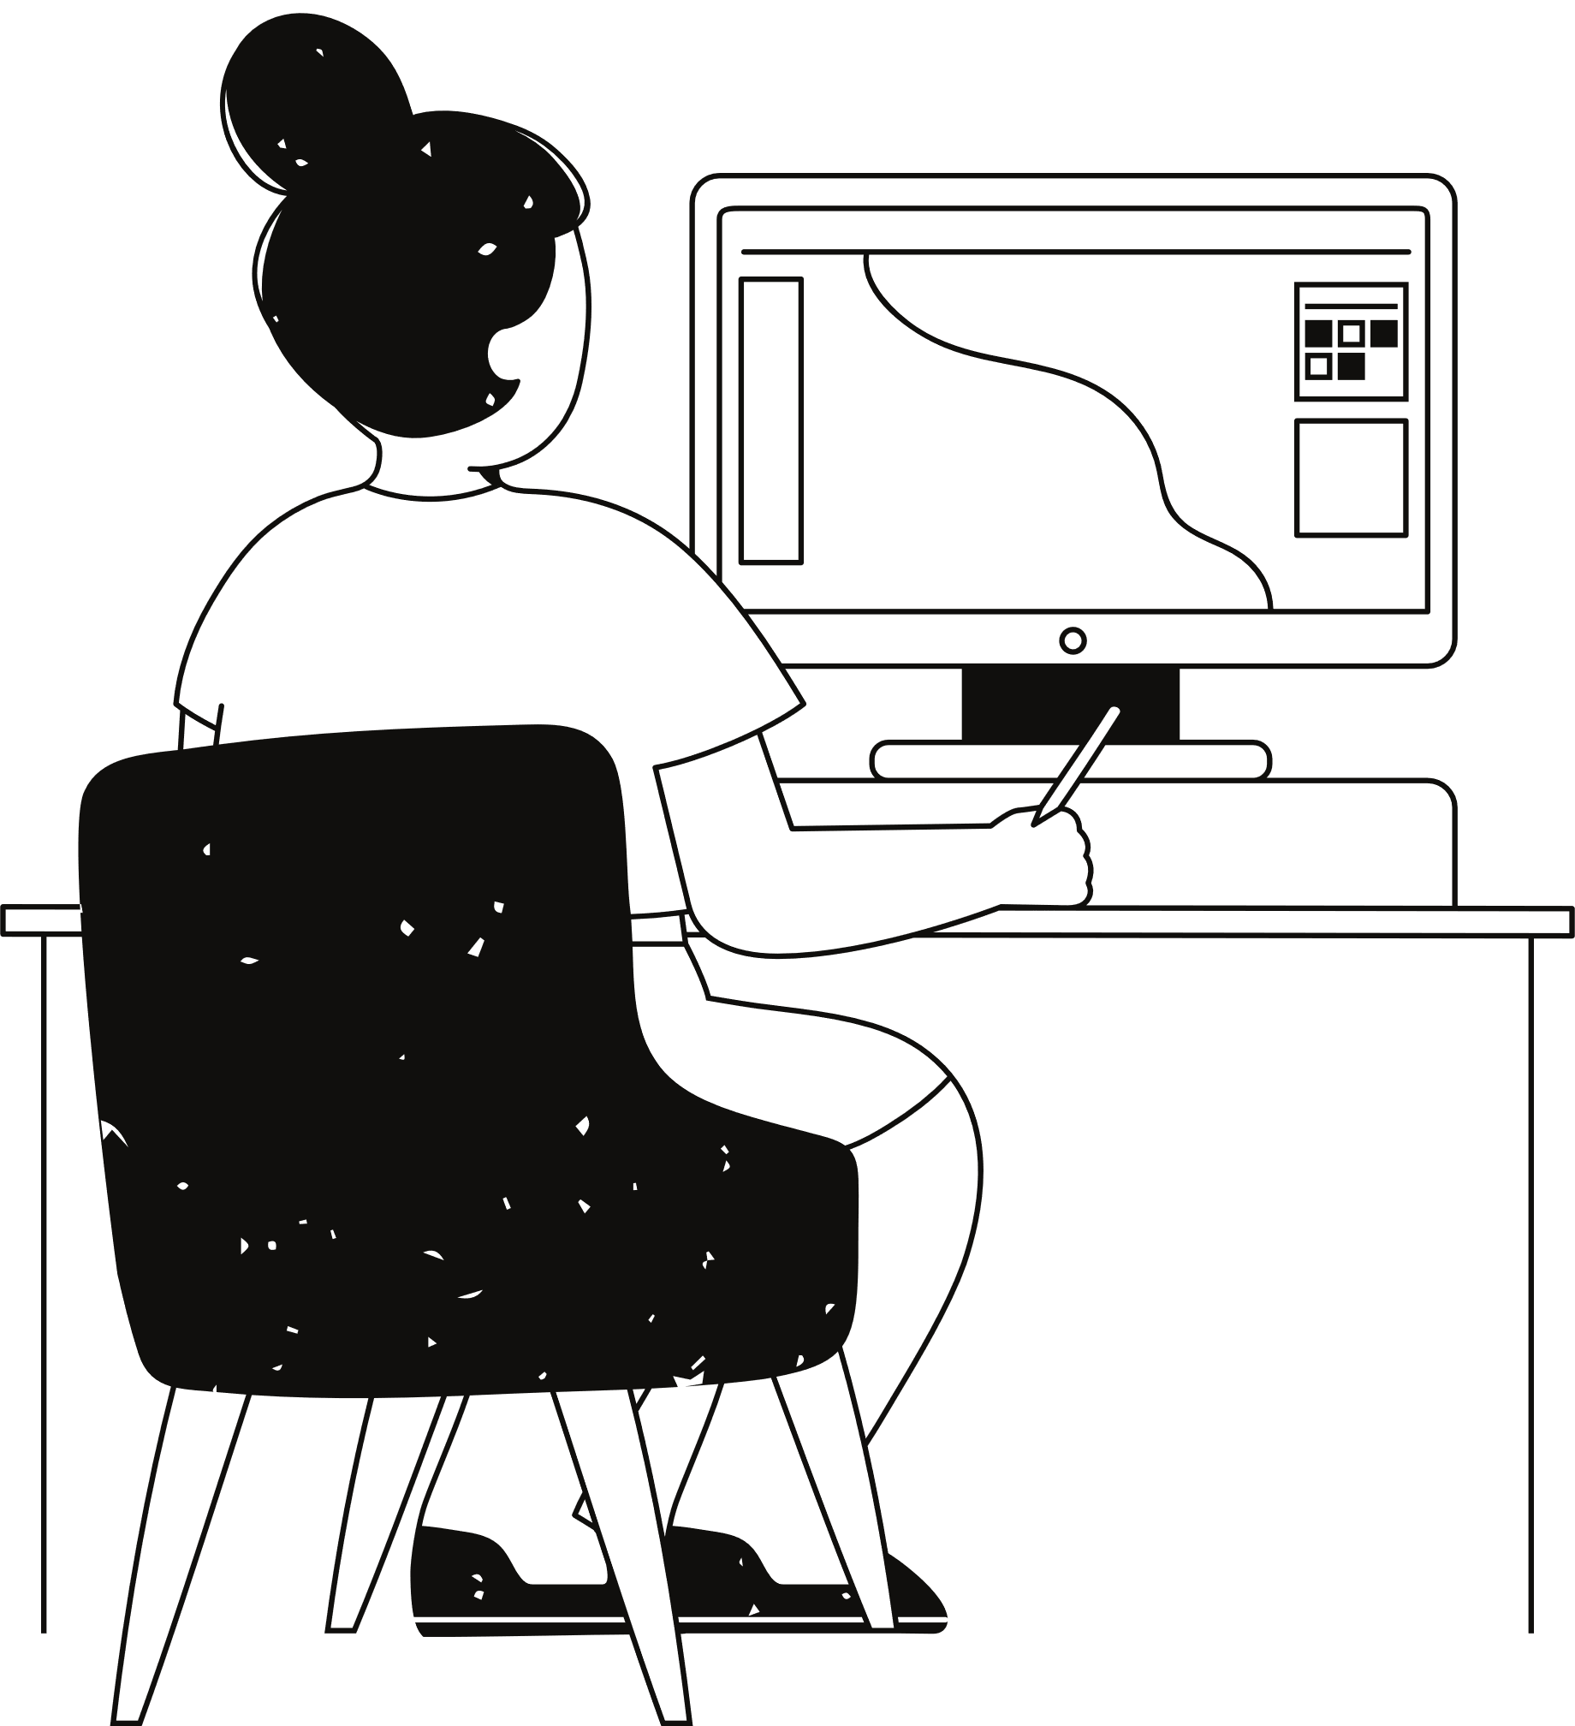
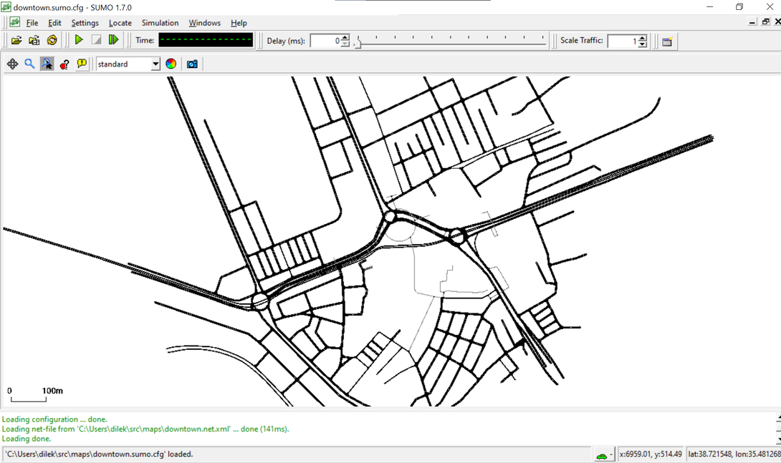
Novelties of My Solution
1. Integration of Multiple Communication Methods:
integrating a variety of communication methods V2I, V2N, and V2V. This comprehensive approach ensures adaptability to various scenarios and enhances the overall robustness of the communication system.
2. Realistic OpenStreetMap Integration:
leverages realistic OpenStreetMap data, intricately integrated into the simulation environment using Java OpenStreetMap Editor.
(Kayseri - Cumhuriyet Meydanı)

Slide 8



Demo
Visual Studio - Console Demo
Omnet ++ - Simulation

Slide 9




Conclusion
Key Issues
1. Scalability Challenges:
The efficient management of a large-scale communication network remains a key challenge that demands further investigation.
Advantages
Disadvantages
1. Complexity in Hybrid Simulation:
The integration of multiple simulation tools introduces complexity in configuration
1. Diverse Communication Methods:
provides versatility and adaptability to different driving scenarios
2. Realistic Simulation Environment:
contributes to a more accurate representation of the driving environment.

Slide 10

Reference List
{1] Talwar, P. (2021). AUTONOMOUS VEHICLE SAFETY OVERVIEW. International Research Journal of Modernization in Engineering Technology and Science, 3(5). https://www.researchgate.net/publication/351824746_AUTONOMOUS_VEHICLE_SAFETY_OVERVIEW
[2] Hanna, R. (2009). The Contribution of Medical Conditions to Passenger Vehicle Crashes. https://crashstats.nhtsa.dot.gov/Api/Public/ViewPublication/811219
[3] S. Kalitzin, G. Petkov, D. Velis, B. Vledder and F. Lopes da Silva, "Automatic Segmentation of Episodes Containing Epileptic Clonic Seizures in Video Sequences," in IEEE Transactions on Biomedical Engineering, vol. 59, no. 12, pp. 3379-3385, Dec. 2012, doi: 10.1109/TBME.2012.2215609.
[4] Chowdhury, M. E., Alzoubi, K., Khandakar, A., Khallifa, R., Abouhasera, R., Koubaa, S., Ahmed, R., & Hasan, M. A. (2019). Wearable real-time heart attack detection and warning system to reduce road accidents. Sensors, 19(12), 2780. https://doi.org/10.3390/s19122780
[5] On the use of opportunistic vehicular communication for roadside services advertisement and discovery - Scientific Figure on ResearchGate. Available from: https://www.researchgate.net/figure/Vehicle-to-Infrastructure-V2I-communication_fig1_309546589 [accessed 10 Dec, 2023]

Slide 11

Link
Presentation Video:
https://drive.google.com/file/d/1AxmGJlLLYB3SWdNVpA-3hsLj5nA5n3Th/view?usp=sharing
Demo Videos: https://drive.google.com/drive/folders/1QB4pIIibxgWxkhRSeJUHvK6crQGYBox4?usp=sharing

Slide 12
Thank you!
Dilek Taylı

